Slide 1

Algebra 1
Unit 14, Lesson 3 Two-Way Tables and Segmented Bar Graphs Volume 2, pg. 316

Slide 2


Benchmarks
MA.912.DP.3.1
Construct a two-way frequency table summarizing bivariate categorical data. Interpret joint and marginal frequencies and determine possible associations in terms of a real-world context.
MA.912.DP.1.1
Given a set of data, select an appropriate method to represent the data, depending on whether it is numerical or categorical data and on whether it is univariate or bivariate.
MA.912.DP.1.2
Interpret data distributions represented in various ways. State whether the data is numerical or categorical, whether it is univariate or bivariate, and interpret the different components and quantities in the display.
volume 2, pg. 316

Slide 3
Integrated Mathematical Thinking and Reasoning Standards
MA.K12.MTR.2.1 Demonstrate understanding by representing problems in multiple ways.
MA.K12.MTR.4.1 Engage in discussions that reflect on the mathematical thinking of self and others.
MA.K12.MTR.5.1 Use patterns and structure to help understand and connect mathematical concepts.
MA.K12.MTR.7.1 Apply mathematics to real-world contexts.
volume 2, pg. 316

Slide 4

Learning Targets
I can correctly match a segmented bar graph and data in a two-way table.
I can interpret a graphical display for bivariate categorical data.
volume 2, pg. 316

Slide 5

Warm-Up
volume 2, pg. 316

Slide 6
14.3.1 Warm-Up: Notice and Wonder
A segmented bar graph is shown.
What do you notice about the display?
What do you wonder?
volume 2, pg. 316

Slide 7

Exploration
volume 2, pg. 317

Slide 8

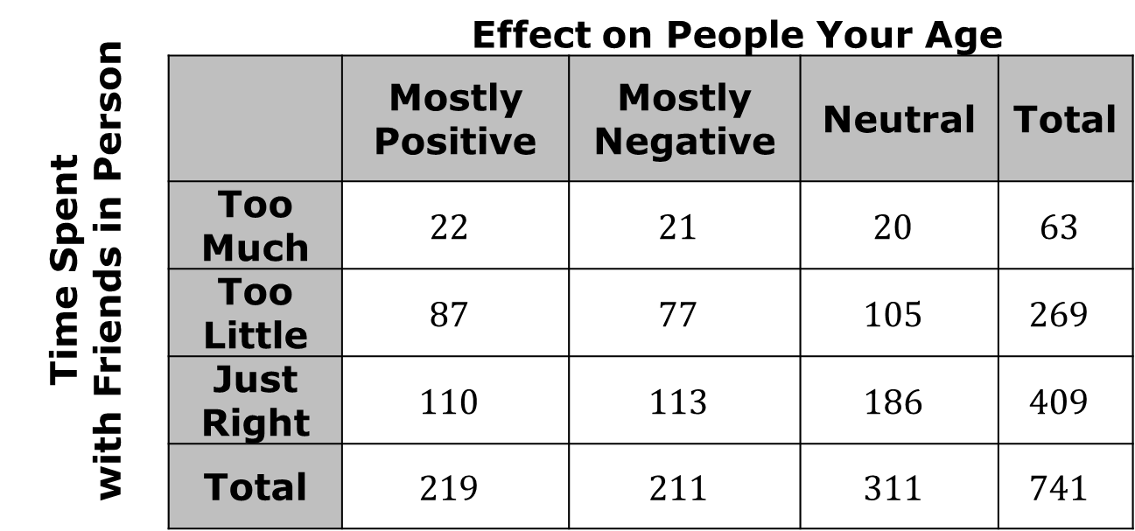
14.3.2 Exploration: Segmented Bar Graphs
Bivariate categorical data can be displayed in a two-way frequency table as shown:
Teen Social Media Survey
Time Spent with Friends in Person |  | Effect on People Your Age
 |  | Mostly Positive | Mostly Negative | Neutral | Total
 | Too Much | $$22$$ | $$21$$ | $$20$$ | $$63$$
 | Too Little | $$87$$ | $$77$$ | $$105$$ | $$269$$
 | Just Right | $$110$$ | $$113$$ | $$186$$ | $$409$$
 | Total | $$219$$ | $$211$$ | $$311$$ | $$741$$
volume 2, pg. 317

Slide 9
It can also be displayed in a segmented bar graph.
volume 2, pg. 317

Slide 10
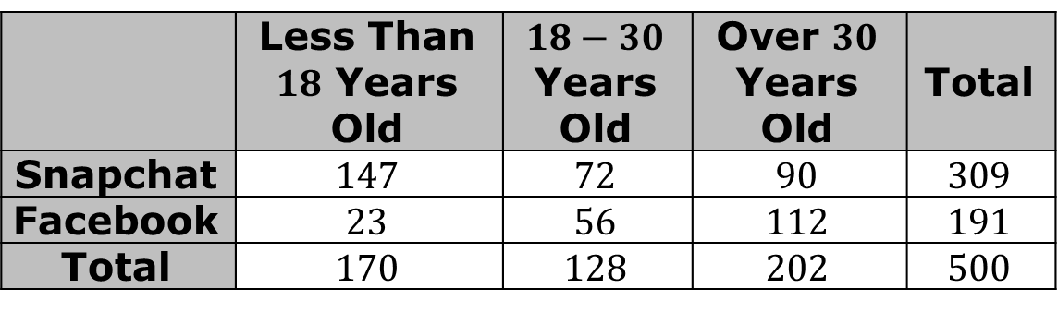
Three two-way frequency tables and four segmented bar graphs are shown.
Table 1
Peoples’ Social Media Preference by Age Group
 | Less Than $18$ Years Old | $18−30$ Years Old | Over $30$ Years Old | Total
Snapchat | 147 | 72 | 90 | 309
Facebook | 23 | 56 | 112 | 191
Total | 170 | 128 | 202 | 500
volume 2, pg. 317

Slide 11
Table 2
Points Scored During a Volleyball Match
 | University of Miami, Florida | Jacksonville University, Florida | Total
Spike Kills | 18 | 22 | 40
Service Aces | 39 | 48 | 87
Other | 20 | 24 | 44
Total | 77 | 94 | 171
Table 3
Emotional States Related to Meditation Practice
 | Meditated | Did Not Meditate | Total
Calm | 52 | 6 | 58
Excited | 11 | 24 | 35
Agitated | 9 | 15 | 24
Total | 72 | 45 | 117
volume 2, pg. 317

Slide 12
Graph A | Graph B
Graph C | Graph D
volume 2, pg. 318

Slide 13
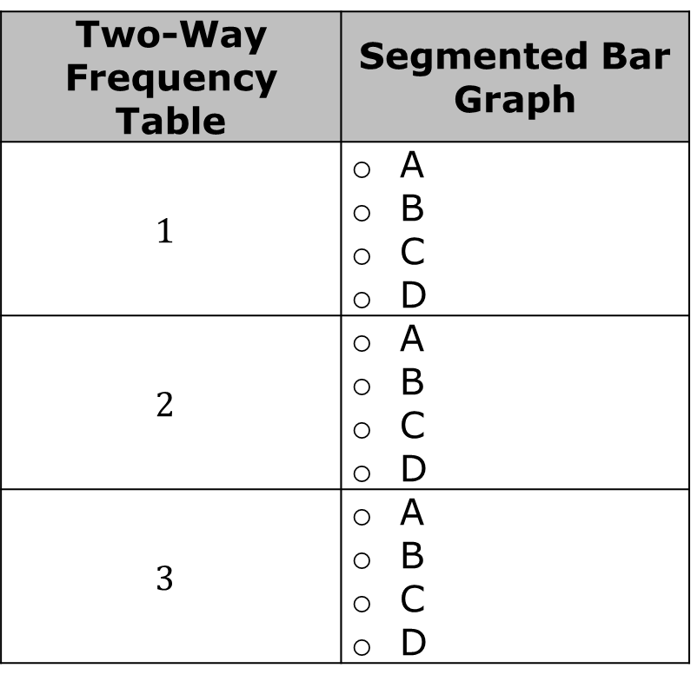
Work with your partner to match each two-way frequency table to the segmented bar graph that displays the same data.
Two-Way Frequency Table | Segmented Bar Graph
$$1$$ | A B C D
$$2$$ | A B C D
$$3$$ | A B C D
volume 2, pg. 318

Slide 14
Work with your partner to label the bars and their sections in the segmented bar graphs so that the categories represented by each bar are indicated.
Discuss with your partner how joint frequencies are displayed in a segmented bar graph. Summarize your discussion.
volume 2, pg. 318

Slide 15

Bring It Together
volume 2, pg. 319

Slide 16

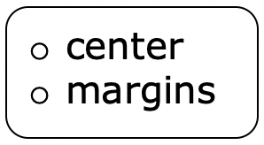
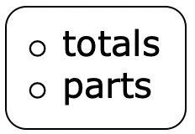
14.3.3 Bring It Together: Representing Bivariate Categorical Data with Segmented Bar Graphs
Another way to represent the bivariate categorical data in a two-way frequency table is with a segmented bar graph.
In a two-way frequency table, marginal frequencies are found in the of the table. These numbers express the of each category.
volume 2, pg. 319

Slide 17
Carolyn concluded that marginal frequencies are represented by the height of each bar on a segmented bar graph.
Bailey argued that the marginal frequencies are represented by the sum of the segment heights with the same color for each color.
Which student do you agree with? Explain your reasoning.
volume 2, pg. 319

Slide 18
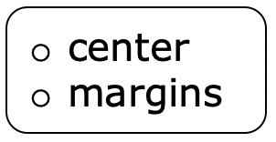
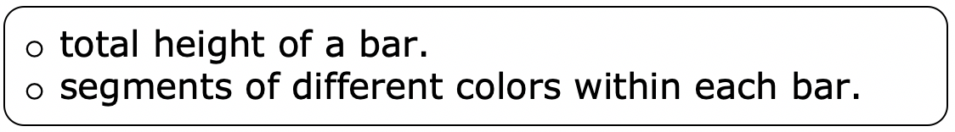
In a two-way frequency table, joint frequencies are found
in the of the table. Joint frequencies are
represented by the
volume 2, pg. 319

Slide 19
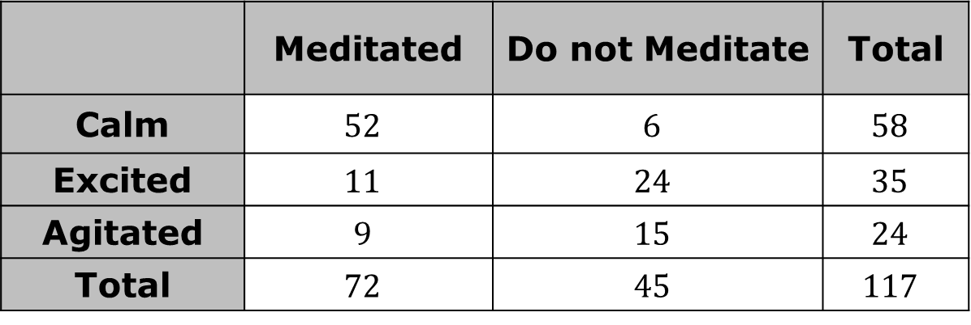
Consider the data in the table and segmented bar graph.
People’s Emotional States Related to Meditation Practice
 | Meditated | Do not Meditate | Total
Calm | $$52$$ | $$6$$ | $$58$$
Excited | $$11$$ | $$24$$ | $$35$$
Agitated | $$9$$ | $$15$$ | $$24$$
Total | $$72$$ | $$45$$ | $$117$$
volume 2, pg. 319

Slide 20
Circle the marginal frequencies in the table.
Label each marginal frequency in the dotted boxes.
Label the value for each joint frequency.
volume 2, pg. 319

Slide 21

Try It
volume 2, pg. 320

Slide 22

14.3.4 Try It: Interpreting Segmented Bar Graphs
Long-haul truckers were recently surveyed at a rest area in Tallahassee, Florida. The truckers were asked about what and how they primarily listen to audio in their trucks while on the road.
volume 2, pg. 320

Slide 23
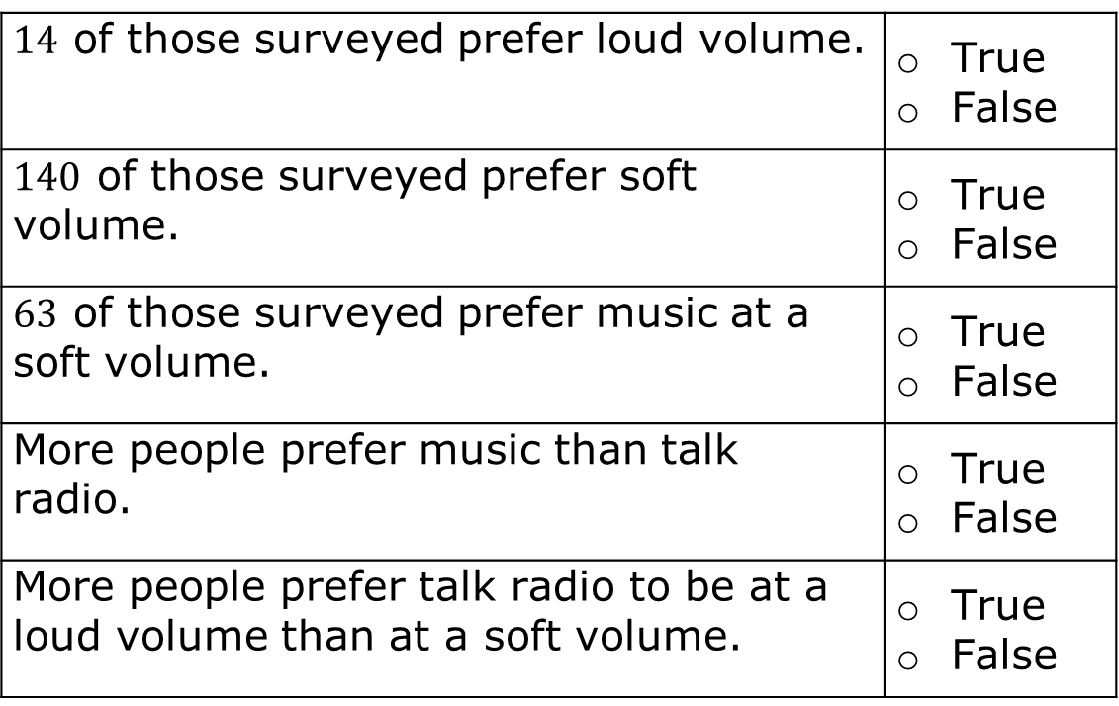
Determine whether each of the following statements is true or false. If the statement is false, correct the statement to make it true.
$14$ of those surveyed prefer loud volume. | True False
$140$ of those surveyed prefer soft volume. | True False
$63$ of those surveyed prefer music at a soft volume. | True False
More people prefer music than talk radio. | True False
More people prefer talk radio to be at a loud volume than at a soft volume. | True False
volume 2, pg. 320

Slide 24

Wrap-Up
volume 2, pg. 320

Slide 25
14.3.5 Wrap-Up: Ticket Out the Door
Macy, Elroy, Bruno, and Karla each kept track of the books they read for a year. Their data is represented in the segmented bar graph shown. Use the segmented bar graph to answer the questions.
volume 2, pg. 320

Slide 26
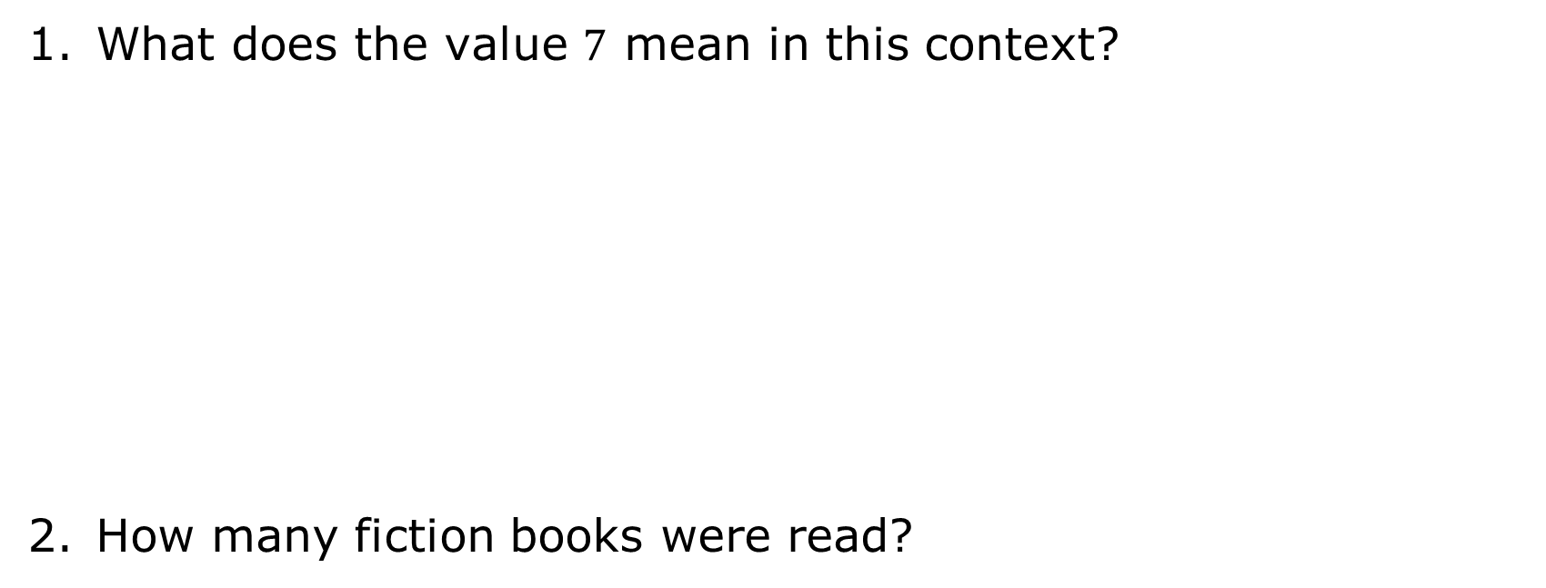
What does the value $7$ mean in this context?
How many fiction books were read?
volume 2, pg. 320

